Slide 1
Introduction to Software Engineering
Skills required to transform requirements into working software
Zeeshan Ali Rana

Slide 2
Tentative Grade Distribution
Quizzes (Announced + Unannounced) – 10 %
Assignments + Project + Class Exercises – 20 %
Mid Term Exams – 30 %
Final Exam – 40 %
Grading Criterion: Absolute
Passing Criteria
  Minimum Attendance Requirements Met
  Minimum Marks Requirements Met

Slide 3
Text Books
Carlo Ghezzi, Mehdi Jazayeri, Dino Mandrioli, Fundamentals of Software Engineering, 2nd Edition. Pearson
Dick Hamlet, Joe Maybee, The Engineering of Software: Technical Foundations for the Individuals. Addison Wesley
Roger S. Pressman, Software Engineering A Practitioner’s Approach, 9th Edition. McGrawHill

Slide 4
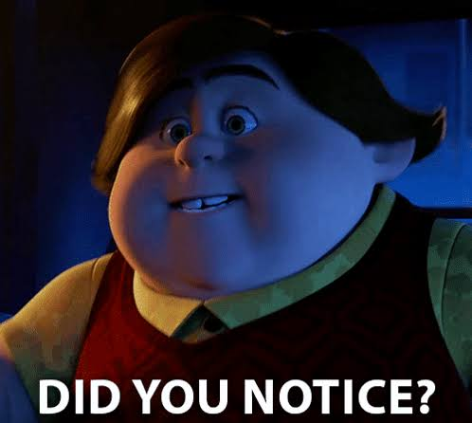
Course Information
Instructor: Dr. Zeeshan Ali Rana
  Office: First F Block building
  Phone Extension: 577
  Office Hours:
    MW: 1130 – 1250
    TR: 1430 – 1550
  Email: zeeshan.rana@nu.edu.pk
  Complete Schedule at: https://sites.google.com/nu.edu.pk/zeeshanr/schedule
TA:
  Office Hours:
  For contact details see Google classroom
There is no lhr in my email address

Slide 5
About Me
Research interests
AI in Software Engineering,
Continuous Requirements Prioritisation,
Compute Efficient Deep Learning,
Retrieval-based Chatbots,
Software Defects,
Software Process Improvement,
Software Estimations,
Software Project Management,
Handling Tacit Knowledge in SE Process,
Managing Technical Debt in SE,
AI in Medicine.
For more info, visit: https://sites.google.com/nu.edu.pk/zeeshanr

Slide 6
Tentative Outline
See document

Slide 7
~ 5.15 million BTC
Size of Software Industry: > USD 600 billion
(Gartner 2022)
Global IT Spending: USD 4.2 trillion
(Gartner 2022)
By 2030 ~ 12 million BTC

Slide 8
Software Development
Size of Software Industry: USD 600 billion
(Gartner 2022)
Resources
Process
Skillset
Lifecycle
Requirements Analysis | Design | Coding | Testing | Deployment | Maintenance
Typical phases in lifecycle of software
The software industry faces many challenges

Slide 9
Challenges for Software Industry
Successful Software Projects ~ 33%
(Standish Group)
Factors Affecting Project Success Rate
Project Size and Complexity
Customer Satisfaction Level
Development and Budget Process
Skills of Developers and Managers
are
These factors are associated with defects. (Jones 2008)

Slide 10
Industry Challenges and Software Defects
Factors affecting Project Success Rate
Customer-Developer Communication Failure
Faulty Definition of Requirements
Documentation, Design, Coding Errors
may result in
cause
Project Success Rate
impact
Cost and Schedule
impact
Defects
Customer satisfaction level
indicate
Lower the defects, higher the software quality.
impacts
indicate
Software Quality
(Kan 2002, Galin 2004, Jones 2008)

Slide 11
Example
#include <iostream>
using namespace std;
int main()
{
int arr[10] = {1,5,5,5,5,4,4,4,2,3};
int arr1[5] = {1,2,3,4,5};
int arr2 [5] = {0,0,0,0,0};
int a = 0;
int b = 0;
for(int i=0;i<10;i++){
for (int j=0;j<5;j++){
if (arr [i] == arr1[j])
arr2[j] = arr2[j]+1;
}
}
cout<<endl;
for(int i=0;i<5;i++){
if(arr2[i]>b){
b=i;
}
}
a = b+1;
cout<<endl<<a;
return 0;
}

Slide 12
Example
#include <iostream>
using namespace std;
int main()
{
int arr[10] = {1,2,3,3,4,6,7,1,2,1};
int a = 0, b = 0;
for(int i=0;i<10;i++){
if (arr[i]>b){
b = arr[i];
if(i==0){
a = b;
}
if(b>a){
int c = b;
b = a;
a = c;
}
}
}
cout<<b;
return 0;
}

Slide 13
Exercise
You have 10 unique non-negative integers stored in an array. The 10 elements are in the range 0 to 20. You need to sort these elements in ascending order. Your sorting algorithm should not have nested loops. If required you can use additional memory to store the sorted elements

Slide 14
Example
#include <iostream>
using namespace std;
int main()
{
int data[10] = {1,5,5,5,5,4,4,4,2,3};
int elements[5] = {1,2,3,4,5};
int frequencies [5] = {0,0,0,0,0};
int mode = 0;
int indexOfMostFrequentElement = 0;
for(int i=0;i<10;i++){
for (int j=0;j<5;j++){
if (data [i] == elements[j])
frequencies[j] = frequencies[j]+1;
}
}
cout<<endl;
for(int i=0;i<5;i++){
if(frequencies[i]>indexOfMostFrequentElement){
indexOfMostFrequentElement=i;
}
}
mode = indexOfMostFrequentElement+1;
cout<<endl<<mode;
return 0;
}

Slide 15
Example
#include <iostream>
using namespace std;
int main()
{
int elements[10] = {1,2,3,3,4,6,7,1,2,1};
int largest = 0, secondLargest = 0;
for(int i=0;i<10;i++){
if (elements[i]>secondLargest){
secondLargest = elements[i];
if(i==0){
largest = secondLargest;
}
if(secondLargest>largest){
int temp = secondLargest;
secondLargest = largest;
largest = temp;
}
}
}
cout<<secondLargest;
return 0;
}

Slide 16
Why is SE Needed?
Software everywhere
  Toaster, Microwave, Temperature control of A/C, Router, Surgical Equipment, search engine, chatbot, air plane, air defense…
    Make lives comfortable, efficient, effective…
SE practices ensure economic development of good software to improve our living standard

Slide 17
Why do we need to study this course?
What could be the benefits?

Slide 18
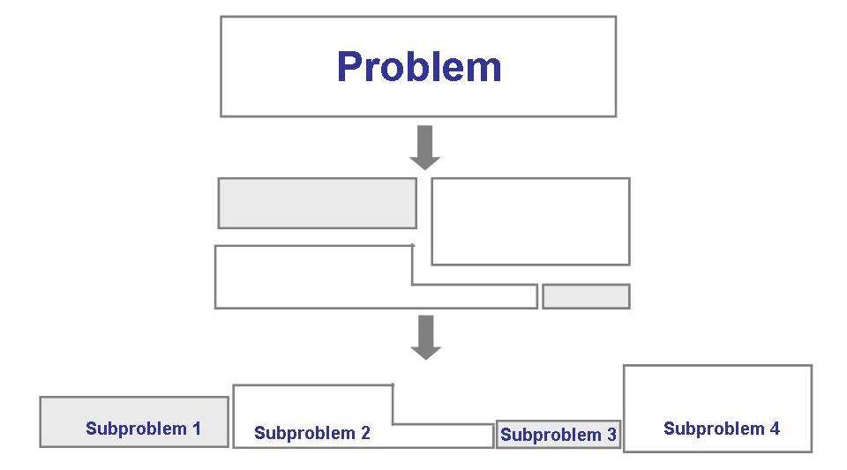
Solving Problems
Analysis

Slide 19
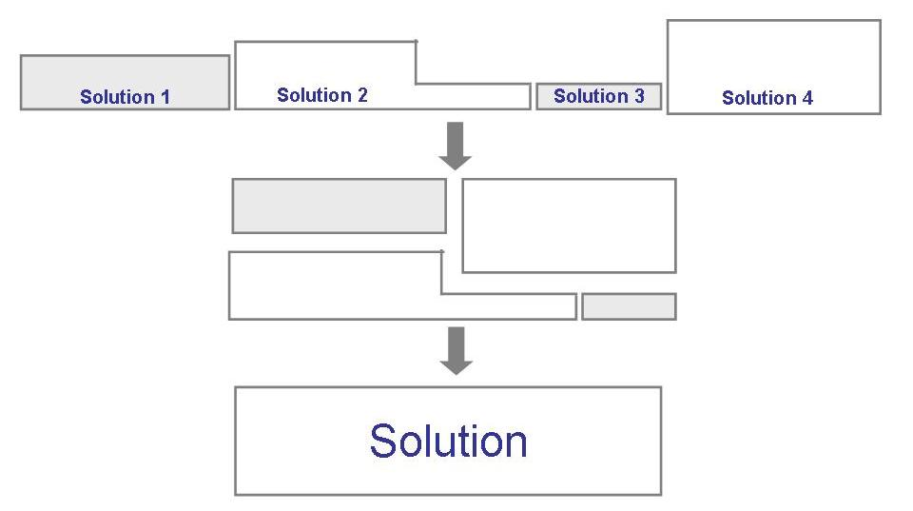
Solving Problems (continued)
Synthesis

Slide 20
Software Engineering
Solving Problems
  Computers
  Computing
Multi-person construction of multi-version software

Slide 21
Software?
Computer programs along with associated configuration data and documentation s.t. the programs are correctly operated
  Configuration data helps set up the programs
  System documentation helps understand structure of the system
  User documentation explains how to use the system
  Example?
 | Fruit 1 | Fruit 2 | Fruit 3
Farmer 1 | Garden 1 | Garden 2 | Garden 3
Farmer 2 | Garden 4 | Garden 5 | Garden 6
Farmer 3 | Garden 7 | Garden 8 | Garden 9

Slide 22
Engineering?
Engineers’ Job?
  Make things work
  Apply theories, methodologies, tools appropriately
  Provide solutions in absence of applicable theories and methods
  Realize financial and organizational constraints

Slide 23
Software Engineering
Solving problems that involve computing and computers?
Solving problems that involve computing and computers in a consistent/systematic manner?
A set of guidelines for solving the computing and computer related problems in a systematic manner?
  Engineering software by remaining concerned about all aspects of software production?

Slide 24
Aspects of Software Production?
Size of the software system to be built
Complexity of the software system to be built
Need and involvement of teams
Technical process of developing software
Activities such as management of project and teams
Development of tools, theories, methods to support production of software

Slide 25
Software Engineering Team

Slide 26
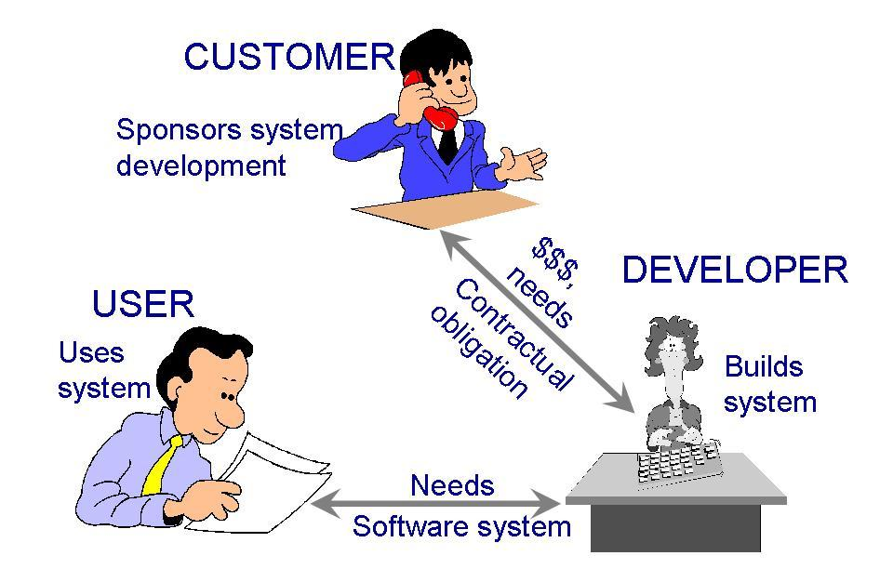
Who Does Software Engineering?
Participants (stakeholders) in a software development project
SOFTWARE ENGINEER

Slide 27
Development/SE Team
Requirements analysts: work with the customers to identify and document the requirements
Designers: generate a system-level description of what the system is supposed to do
Programmers: write lines of code to implement the design
Testers: catch faults
Trainers: show users how to use the system
Maintenance team: fix faults that show up later
Librarians: prepare and store documents such as software requirements
Configuration management team: maintain correspondence among various artefacts

Slide 28
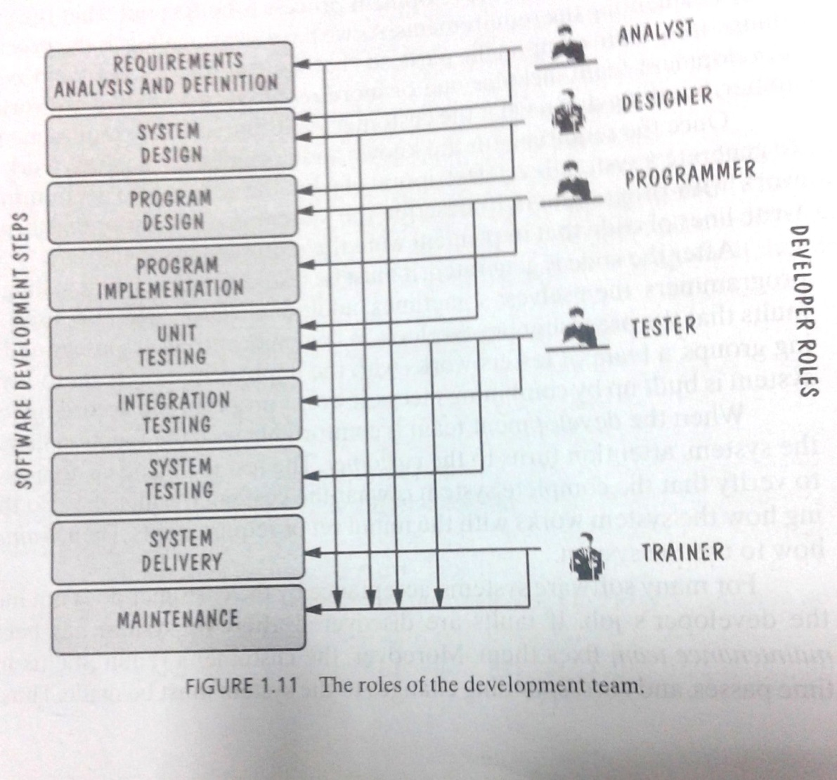
Development Team (Roles)
Who Does What?

Slide 29
Software Lifecycle
Phases
  Requirements analysis and definition
  System (architecture) design
  Program (detailed/procedural) design
  Writing programs (coding/implementation)
  Testing: unit, integration, system
  System delivery (deployment)
  Maintenance

Slide 30
Software Engineering and Software Quality

Slide 31
Software Engineers?
Adopt a systematic and organized approach, effectively, to produce high quality software
May have to use Ad hoc approaches to develop software
    Some real complex problems may not be solved using elegant theories of CS
    new algorithms?
Adopt a systematic and organized approach, effectively, to produce high quality software
May have to use Ad hoc approaches to develop software
    Some real complex problems may not be solved using elegant theories of CS
    new algorithms?
Improve living standards

Slide 32
Defects and Software Quality
Defect
  Failure to meet requirements (or expectations) of user/customer (Kan 2002)
Software Quality
  Fitness for Use (Juran and Gryna 1970)
  Conformance to Requirements (Crosby 1979)
  Freedom from Deficiencies (Juran 1988)
  Lack of Defects (Kan 2002)
Removal of defects, increases quality, incurs cost.

Slide 33
Cost Associated with Defect Correction
Unit Cost to fix a defect
Defects prevention can reduce costs.
Requirements Analysis | Design | Coding | Testing and Deployment* | Operations
*Testing the system before delivery and at the time of delivery
(Khoshgoftaar et al. 1996 , Galin 2004)

Slide 34
Costs in Software Engineering
Cost to change software
Cost to overcome a mistake (defect)
Cost of developing software
Operational cost
Deployment cost

Slide 35
Software Engineering Challenges
… good enough software
Acceptable Quality
  Usability
  Security
  Reliability
  Performance
Cost Effectiveness
  Engineering and operational feasibility
  Limited development budget
Timely Completion
  Limited time
Conflicts?
Manage Conflicts…

Slide 36
Software Engineering
Disciplined, consistent, and systematic effort to construct (design + build) and maintain software in timely and cost-effective manner

Slide 37
References
Roger Pressman, Software Engineering: A Practitioner’s Approach
Ghezzi et al., Fundamentals of Software Engineering
Pfleeger et al. Software Engineering, Theory and Practice

